Slide 1
Loan Eligibility Dataset

Slide 2
Problem Description
There is a significant need for companies and banks that specialize in providing home loans to efficiently assess customer eligibility. When a customer applies for a home loan, the company needs to evaluate the customer's eligibility based on various details provided in the online application form:
Gender
Marital Status
Education
Number of Dependents In our dataset we have 614 Sample * 13 feature
Applicant's Income
Co applicant's Income
Loan Amount
Loan Amount Term
Credit History
Property Area

Slide 3

Column Description
Column | Description | Values Range | Distribution | Null Count
Loan ID | # | # | # | 0
Gender | Applicant gender | {Male , Female} | 18% F ,82% M | 13
Dependents | No. of family members | {0,1,2,+3} | [ 57 ,17 ,17 ,8 ] | 15
Education | Applicant Qualification | {Graduated , Un Graduated } | [78% , 22% ] | 0
Property Area |  | {Semi Urban , Urban ,Rural } | [39,31 ,30] | 0
Self Employed |  | {No, Yes} | [81 ,19] | 32
Married | Martial Status of the applicant | {Yes , No } | [ 65, 35 ] | 3
Loan Status | Loan eligibility status | {eligible , not eligible} | [ 68 ,32 ] | 0

Slide 4
Column Description
Column | Description | Values Range | Distribution | Null Count
Credit History | Applicant old Credit | {Yes, No} | [73 , 27] | 50
Loan Amount |  | [108, 550] | [mean : 136 , STD :61 , Normal ] | 14
Applicant Income |  | [0, 72000] | {mean : 4805, STD :4910 , Skewed Left } | 0
Co app. Income |  | [0,24000] | {mean : 1569 , STD :2334 ,Skewed Left } | 0
Loan Amount Term |  | [6,480 ] | {mean : 342 , STD :65 } | 22

Slide 5
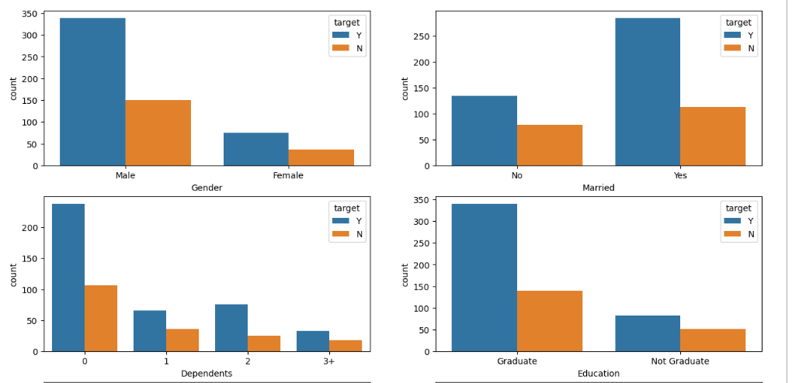
Column Description

Slide 6
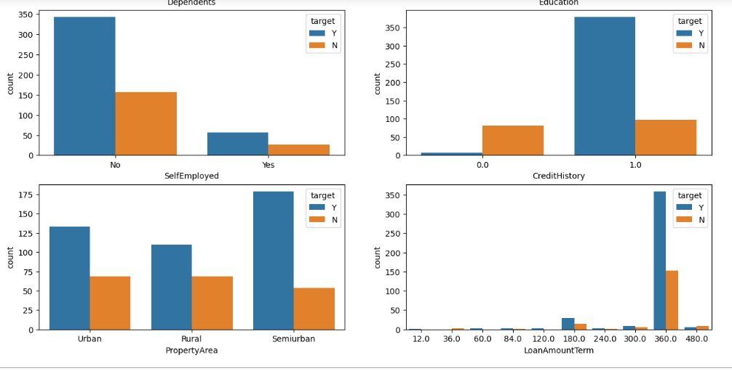
Column Description

Slide 7
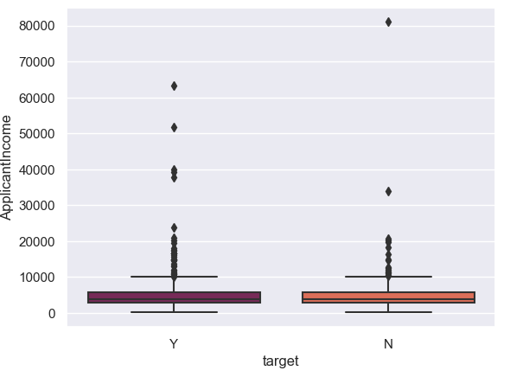
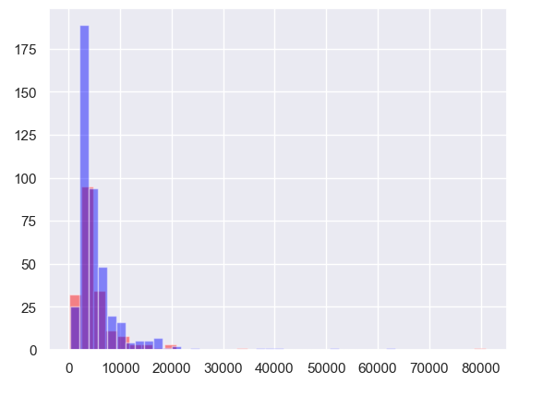
Column Description

Slide 8
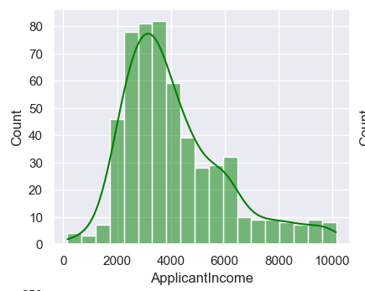
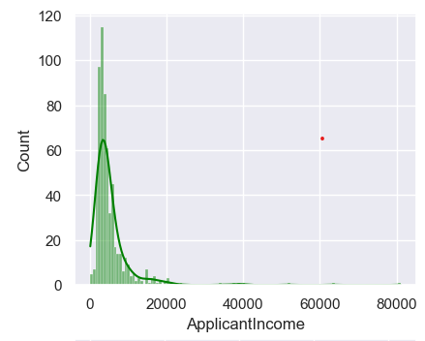
Column Description

Slide 9
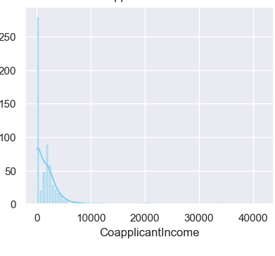
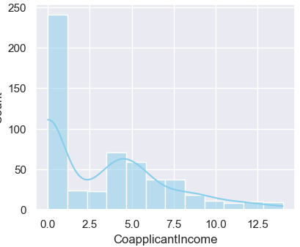
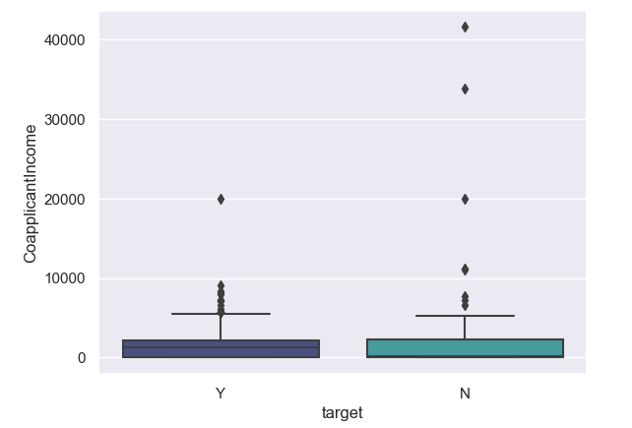
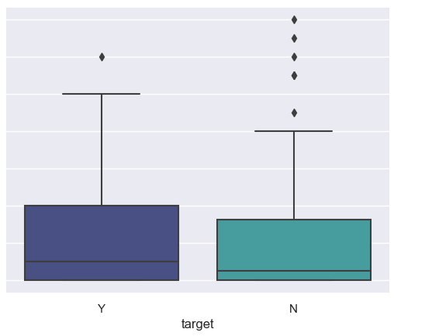
Column Description

Slide 10
Data Preprocessing
1
Features Cleaning
4
Scaling the data
2
Feature Encoding
5
Heat map to show the correlation
3
6
Discretizing , Out layers identification
Drop Unrelated Column
Null Accuracy : 69 %
Train Null Accuracy: 68 %
Testing Null Accuracy : 70 %

Slide 11
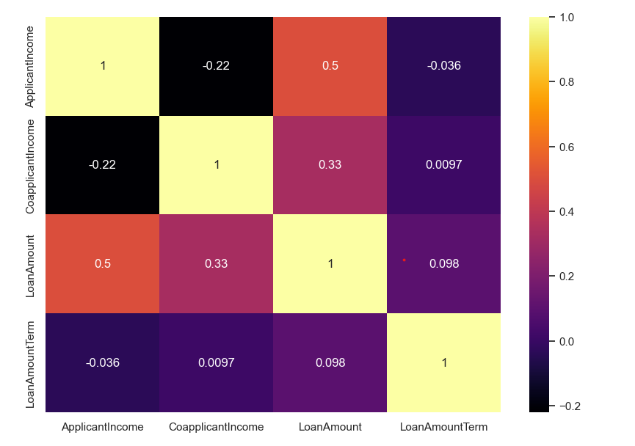
Numeric Data Correlation

Slide 12
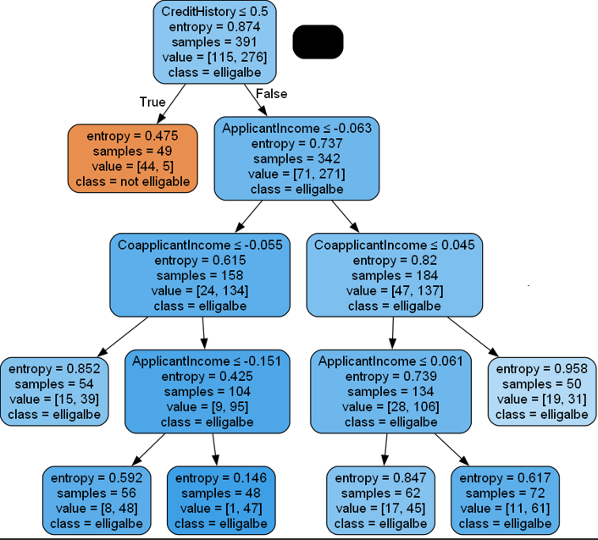
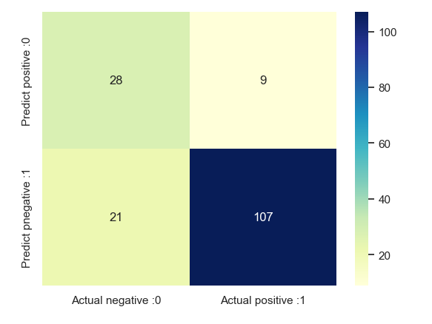
DT Hyper Parameters Tuning
1

Slide 13
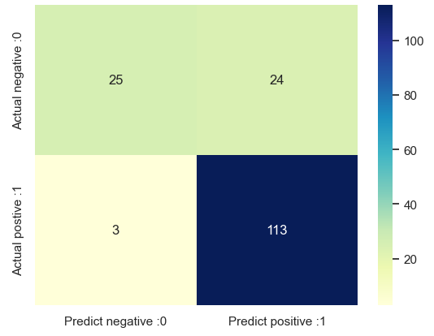
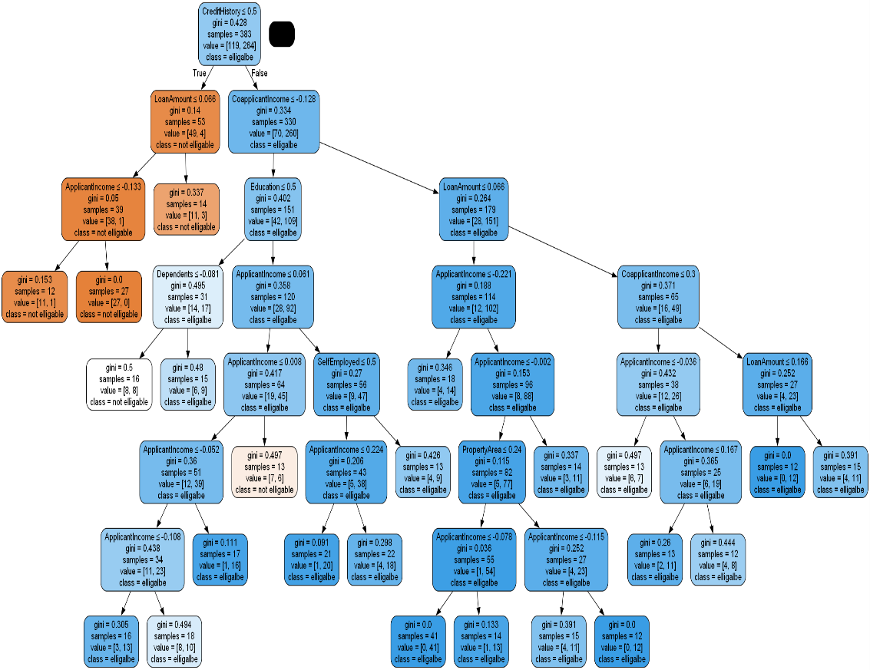
DT Hyper Parameters Tuning
1

Slide 14
SVM Hyper Parameters Tuning
Choose the kernel then tune the C , Gamma
Kernel | Accuracy
Linear | 85
Polynomial | 83
rbf | 75
*: the Linear and poly kernels work good
So we chose them to tune there Hyper Parameters

Slide 15
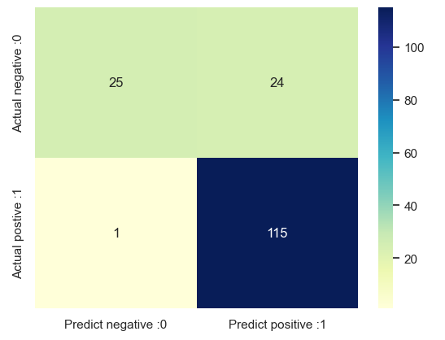
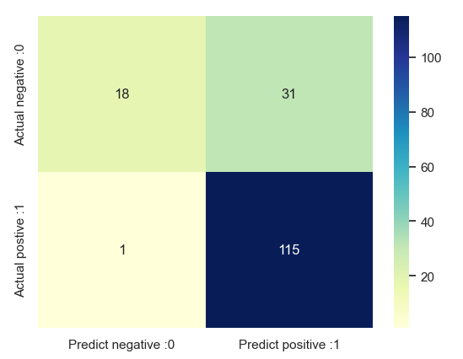
Linear . Poly
Linear
poly

Slide 16
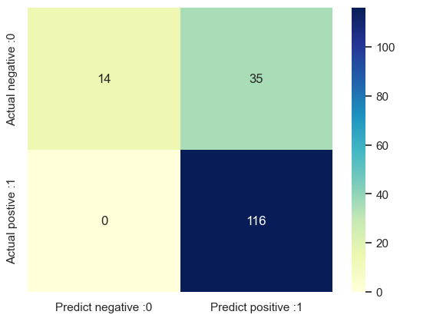

KNN Hyper Parameters Tuning
We have the k and the weight to tune them
We got very low negative Recall

Slide 17
Models Classification Reports
All the model have a similar result
The KNN was the worst
The best two are Linear SVM and DT
Model | Accuracy | Precision | Recall | F1 score
Decision Tree | 84 | 82 | 97 | 89
Linear SVM | 85 | 83 | 99 | 90
Non-Linear SVM | 81 | 79 | 99 | 88
KNN | 79 | 77 | 79 | 87

Slide 18
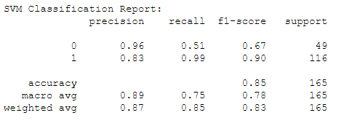
Best Model Describe : Linear SVM
Tuning the Model for a low value of C ,Gamma
For all model we cannot get a good negative recall
In our problem we care of the Precision
K Fold Cross Validation give a average accuracy 0.82

